Slide 1
FIXED INCOME FINAL PROJECT PREDICTING THE FED FUND EFFECTIVE RATES: A MACHINE LEARNING APPROACH
Derick Hanscom,
Jharold Montoya,
Kaiyu Wen,
Yuqiang Zhang,
Leyi Hu,
Tristan Ko
Notes:
Good morning everybody. The title of our project is predicting the fed fund effective rate: a machine learning approach.
I am enfasizing effective because our initial goal was to predict the fed fund target rate, but since the FOMC meets eight times a year to determine that target rate (so 8 observations per year) and basically all our data come in a monthly basis (so 12 observations per year) our dependent and independent variable frequencies didn’t match, so we decided to change the target rate for the effective rate which is essentially determined by the market but is highly influenced by the Fed through open market operations to reach the fed target rate.

Slide 2
CONTENT
Introduction
Project description
Data
Models
Results
Improvements
Notes:
Jharold
So brief introduction
What did the work flow look like
the data
machine learning models
results
and some future improvements that can be made to our job

Slide 3
INTRODUCTION
Why is the interest rate important?
The fed funds rate impacts short-term and long-term interest rates as well as foreign exchange rates. It also plays into broader economic considerations, like growth and employment.
According to the US economic and financial data, Is it possible to build a model to predict the interest rate and the Fed's action?
Notes:
Jharold
So why is our project important?
it impacts short-term and long-term interest rates as well as foreign exchange rates. So market variables. But also economic activity. variables like growth and employment.
So, since is such an important variable. Is it possible to build a model to predict the interest rate and the fed action?

Slide 4
PROJECT DESCRIPTION
Collection
Pre-processing
Model descriptions
Model Training and Validation
Lasso Feature Selection
Full Features
Top 10 Features
Data
ML models
Results
Notes:
Jharold
We will discuss in detail what type of data did we choose to feed our models and how did we adjust some of the initial variables to get better results.
We will also talked about the machine learning model we will used and a technique that will allow us to identify the most important variables
Finally we will talked about the results using all the variables vs using only the most important variables.

Slide 5
DATA
ECONOMIC ACTIVITY | PRICES | FINANCIAL CONDITIONS
Industrial Production Non-farm payrolls Consumer Confidence Initial Jobless Claims Unemployment rate Labor Market Participation Personal Consumption Expenditures Total Vehicle Sales Boom Bust | Consumer Price Index (CPI) 1.1 First order derivative 1.2 Second order derivative Core CPI Bank of New York – Survey of inflation Sentiment Michigan Inflation Expectations Bank Prime Loan Rate 6.1. First order derivative 6.2. Second order derivative | National Financial Conditions Index – Chicago Fed Fed Fund Rate lagged one month
Notes:
Tristan/Charlie

Slide 6
DATA
PRICES
FINANCIAL CONDITIONS
Consumer Price Index (CPI)
1&2 order derivative
Fed Fund Rate lagged one month
capture the trend and momentum of inflation
account for the time series properties
Notes:
Tristan/Charlie

Slide 7
MODELS
Linear:
Logistic
LDA
Non-Linear:
QDA
SVM
KNN
LSTM
Gradient Boost
Random Forest

Slide 8
Results
Full Features
Model | ROC AUC (Train | Validation) | F1 weighted (Train | Validation) | Imbalanced Accuracy (Train | Validation)
Logistic | 85.53 | 62.46 | 69.66 | 75.76 | 60.42 | 33.33
LDA | 84.68 | 75.20 | 68.91 | 74.36 | 59.99 | 32.22
QDA | 82.39 | 80.75 | 66.56 | 75.83 | 56.65 | 37.17
KNN | 86.79 | 66.56 | 68.32 | 80.44 | 59.74 | 44.34
SVM | 74.22 | 51.72 | 62.91 | 73.98 | 52.33 | 52.46
Random Forest | 84.60 | 56.30 | 50.68 | 79.66 | 38.96 | 39.39
XGBoosting | 87.88 | 85.70 | 68.81 | 84.15 | 59.03 | 56.09
Sequential Neural Network | 86.09 | 71.89 | 67.36 | 77.02 | 57.57 | 42.49
LSTM | 84.02 | 67.68 | 66.11 | 76.43 | 54.66 | 37.54

Slide 9
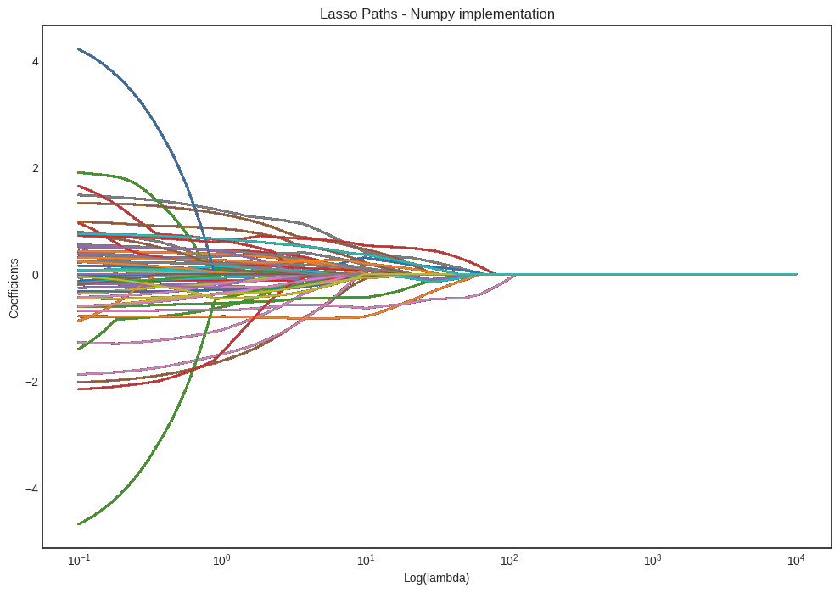
LASSO Feature Selection
Top 10 Features: Fed Rate Lag, Bank Loan Rate, Labor Market Participation, CPI Acceleration, Core CPI, Consumer Opinion Survey, Personal Consumption Expenditure, Sentiment, CPI, Industrial Production

Slide 10
Results
Top 10 Features
Model | ROC AUC (Train | Validation) | F1 weighted (Train | Validation) | Imbalanced Accuracy (Train | Validation)
Logistic | 82.53 | 68.31 | 68.03 | 80.44 | 58.09 | 44.34
LDA | 82.27 | 62.89 | 67.25 | 79.24 | 57.10 | 43.60
QDA | 77.09 | 59.01 | 62.44 | 75.76 | 52.97 | 33.33
KNN | 84.04 | 79.96 | 66.19 | 77.84 | 56.68 | 36.36
SVM | 75.12 | 65.60 | 64.48 | 80.60 | 58.13 | 56.90
Random Forest | 84.12 | 52.92 | 63.47 | 79.66 | 51.17 | 39.39
XGBoosting | 99.67 | 63.88 | 96.91 | 79.08 | 95.67 | 48.18
Sequential Neural Network | 71.54 | 54.50 | 59.55 | 75.30 | 48.04 | 32.96
LSTM | 85.65 | 69.73 | 69.77 | 85.58 | 60.73 | 54.18

Slide 11
Top Models
Top Model: SVM with a polynomial kernel using the LASSO top ten features
Second Model: XGBoosting using all the features
SVM is one of the most popular classification algorithms due to its ability to be represented through many kernels. Using our optimized SVM model, this was the only model to correctly classify any upward predictions.
XGBoosting is another popular classification algorithm that uses a set of decision trees to develop a generalized model. Using our optimized XGBoosting algorithm we were able to finely define the border between 0 and 1 (down and maintain)

Slide 12
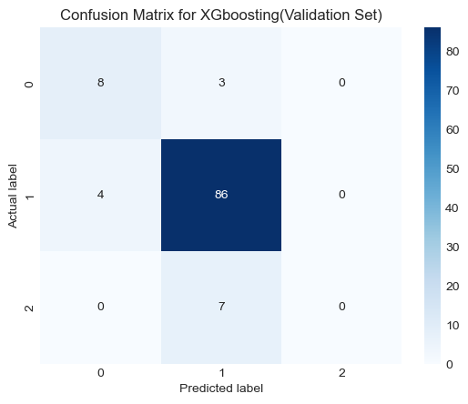
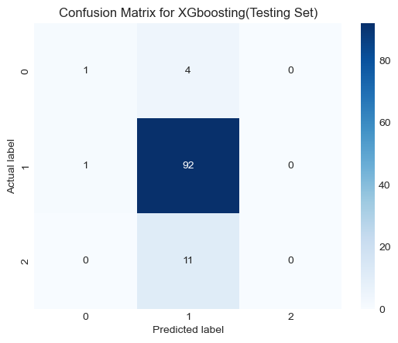
Testing
XGBoosting Full Features
ROC AUC | 84.32%
F1 Weighted | 79.81%
Imbalance Accuracy | 39.64%
Unfortunately, like all the other models, we are unable to correctly classify upward movement in the federal fund rate.

Slide 13
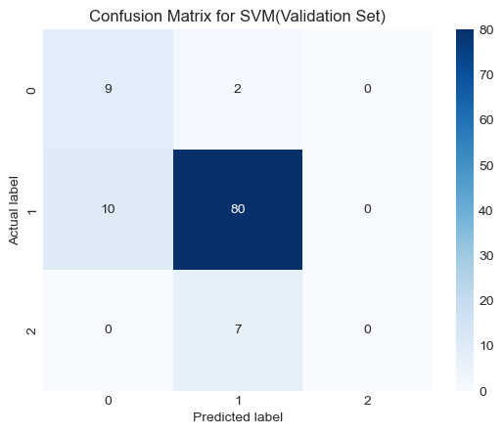
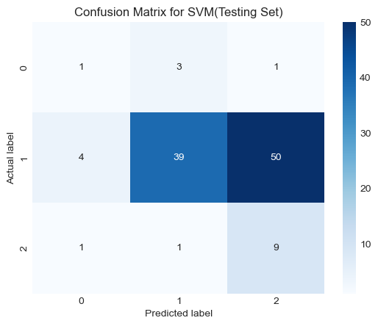
Testing
SVM(polynomial) Top 10 Features
ROC AUC | 68.89%
F1 Weighted | 52.33%
Imbalance Accuracy | 47.92%
We can actually predict 90% of the ups correctly! However, the prediction for the maintain is worse because the border between 1 and 2 is not optimally defined.

Slide 14
EXPLANATION FOR ASYMMETRY IN RESULTS
REGIME CHANGE
ECONOMIC CYCLE
FOMC MEMBER EVOLUTION
FED MANDATE
Notes:
Now that we saw the asymmetry in our predictions for increasing vs decreasing rates, we wanted to mention some reasons that might help explain this phenomenon.
And they all are connected with a regime change
So in terms of economic cycle for example, if we are experiencing recession, every economic agent want lower rates because lower rates will help bust activity
but if we are in expansion, even if there are signs of early inflation in the data, no economic agent wants higher rates, which will slow the economy.
FOMC members evolution can help explain this asymmetry as well, going from a hawkish comite to a dovish one will affect how decisions are made facing the same data.
Finally a change in the fed mandate can impact as well. Prior covid the inflation fed goal was 2% but after the covid crisis and the expansion economic packages deployed by multiple countries in the world, the fed change the mandate for 2% over the longer run with the aim to allow for longer inflation period and recovery, unfortunately bringing with this more uncertainty to the economic agents.

Slide 15
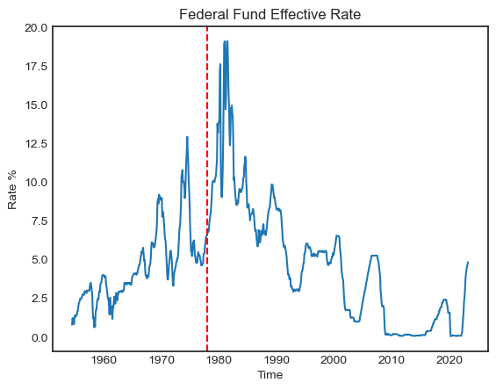
IMPROVEMENTS
Collect longer history of data for the features
Incorporate NLP techniques towards the FOMC Minutes
Extract important features which FOMC considers
Use the Minutes to the actual prediction
Ensemble multiple ML models toward the final prediction
Introduce a rolling window to localize the regimes in time

